Slide 1
A Thesis Proposal
On
“Optimization of Unsupervised
Image - to - Image translation using Semantic Based Techniques”
Presented by:
Avishek Kuinkel
Symbol Number: 7925002

Slide 2
Table of Contents
INTRODUCTION
BACKGROUND STUDY AND LITERATURE REVIEW
METHODOLOGY
Description of Methodology
Flowcharts Depicting Methodology
Description of Data
Description of Algorithms/ mathematical Models
WORKING SCHEDULE AND EXPECTED OUTCOMES
Working Schedule
Expected Outcome
References

Slide 3
Introduction
Image-to-image translation is the task of taking images from one domain and transforming them so they have the style (or characteristics) of images from another domain.
The goal of I2I is to convert an input image from a source domain A to a target domain B with the intrinsic source content preserved and the extrinsic target style transferred.
Supervised methods usually produce better translated results than unsupervised methods on similar network structure and labeled data.
There is a need for the unsupervised Semantic Based I2I translation to reduce lots of manual tasks in image labelling and to obtain the better results in Unsupervised I2I translation.

Slide 4
Background Study
The concept of image to image (I2I) interpretation has experienced noteworthy advancement, getting to be a foundation within the field of computer vision.
I2I translation's core objective is to convert a picture from one space to another while protecting its inborn substance, an errand that has seen significant refinement and development over a long time.
cGANs are flexible and general-purpose arrangements for a wide range of I2I interpretation issues.
WGAN has enhanced our understanding of the challenges with traditional GANs, such as poor convergence and mode collapse, and has offered solutions to improve the quality of the generated outputs.
DualGAN presents a bidirectional learning model for image-to-image translation, drawing inspiration from dual learning techniques in natural language processing and adapting them for the image translation field

Slide 5
Literature Review
Author explore an innovative approach to image- to-image translation that emphasizes preserving the intrinsic semantics of images, even amidst geometric variations between the source and target domains. They present a GAN strategy that leverages semantic information encoded as segmentation masks. A key technical advancement is the development of an encoder-decoder generator architecture, which concurrently processes both the image and its semantic details, achieving simultaneous translation to the target domain.[4]
The authors modified the traditional GAN architecture by adapting the discriminator to perform an additional task of classifying input into one of the N classes, with an extra class for generative outputs. The training algorithm outlined in the paper, which leverages gradient descent on the discriminator/classifier’s outputs, offers a practical framework that could be instrumental in implementing the 'warm start' strategy in our research. This paper's findings and methodologies provide a robust theoretical and practical foundation for employing labeled data in enhancing the performance of unsupervised image-to-image translation, particularly in the context of semantic-based techniques [5]

Slide 6
Problem Statement
Unsupervised image-to-image (I2I) interpretation faces challenges due to the reliance on expansive datasets of labeled pictures for preparing conditional GANs (cGANs).
While the DualGAN approach enables training with unlabeled images from different domains, it struggles with tasks involving complex semantic labels compared to cGANs.

Slide 7
Objective
To significantly reduce reliance on large datasets, making unsupervised I2I translation more practical in scenarios with scarce annotations.
To improve the performance of DualGAN for semantic-based image-to-image translation by leveraging labeled data as a pre-training step.

Slide 8
Description of Methodology
The process starts by gathering datasets
Collected images undergo standardized preprocessing steps to ensure consistency and improve model performance.
3. The processed data is divided into paired data & unpaired data.
4. A preliminary training stage uses paired (aligned) examples to teach GAN_A and GAN_B the basic relationship between domains A and Stabilize early learning and initialize generators (G_A, G_B) and discriminators (D_A, D_B).
5. After warm-start training, the model transitions to full unsupervised learning using unpaired data in the DualGAN structure
6. Model performance at each hyper parameter setting is monitored, and the combination producing the best results is chosen.

Slide 9
The trained model is evaluated using Mean Squared Error, Fréchet Inception Distance and Structural Similarity Index.
The optimized model is compared against the baseline original DualGAN to assess improvements in translation quality, reductions in error and better preservation of structure and realism.

Slide 10
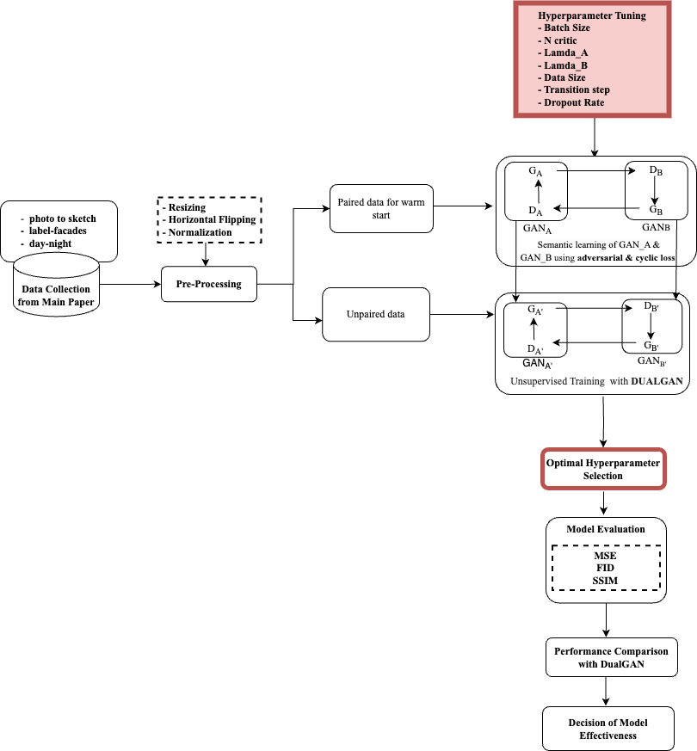
Flowcharts Depicting Methodology

Slide 11
Description of Data
The PHOTO–SKETCH dataset consists of 995 training and 199 test grayscale images with 256 × 256 dimensions that are coupled with photographs and sketches.
The DAY–NIGHT dataset, which consists of 80 training and 10 test RGB photos of size 512 × 512, provides pairings of scenes taken during the day and at night.
The LABEL-FACADES dataset, which consists of 400 training and 100 test RGB images with 256 × 256 dimensions, provides facade images with matching label maps

Slide 12
Dataset preparation
Resizing: The images are resized to a square format with dimensions of 128 × 128 pixels.
Normalization: It involves adjusting the pixel values of images to fall within the range [-1, 1] by dividing them by 127.5 and then subtracting 1. This standardized procedure aids in stabilizing the learning process of neural networks and accelerates convergence speed.
Horizontal Flipping: It involves randomly flipping images horizontally with a 50% probability during the training phase but not during testing. This data augmentation method enhances the variety of the training dataset, helping the model to better generalize to different image orientations.
Supervised and Unsupervised Split in Training Data: Within the training set, a further subdivision creates a unique environment to leverage both supervised and unsupervised learning paradigms. By allocating a small percentage of the training data to the supervised subset and a larger percentage to the unsupervised subset (e.g., a 1:9 ratio), this study aims to investigate how such a hybrid learning approach influences the overall efficacy and accuracy of the classifier.

Slide 13
Description of Algorithms
This innovative model is engineered to adeptly navigate the challenges of image processing allows it to perform complex translation tasks between two domains, referred to as Domain A and Domain B.

Slide 14
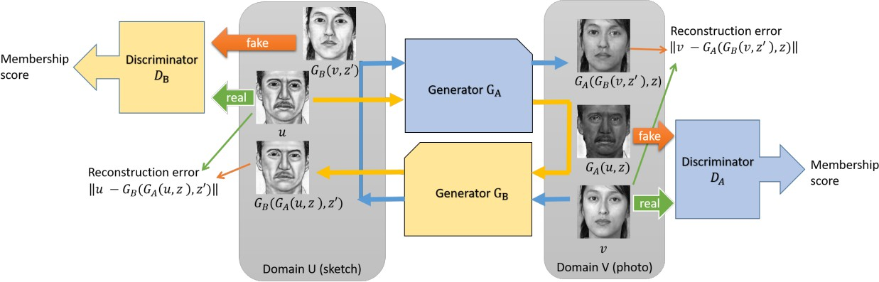
Dual GAN Architecture

Slide 15
Generator
They are responsible for the translation between domains. The A-to-B generator (A2B) translates images from domain A to domain B, and the B-to-A generator (B2A) does the opposite.

Slide 16
Discriminators
Each domain has a discriminator that learns to distinguish between real and generated (fake) images within that domain. The A discriminator (Ad) differentiates between real images from domain A and fake images generated by B2A, while the B discriminator (Bd) differentiates between real images from domain B and fake images generated by A2B.

Slide 17
Modified Dual GAN
The final model integrates learnings from both supervised and unsupervised.
It becomes capable of translating images between domains A and B, both with and without direct pairings.

Slide 18
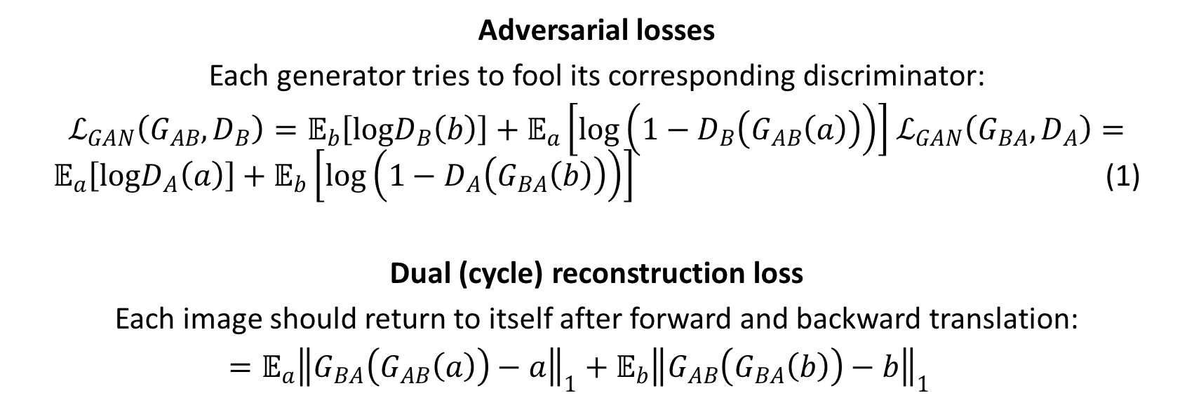
Mathematically
Adversarial losses
Each generator tries to fool its corresponding discriminator:
$ℒ_{GAN}\left(G_{AB},D_{B}\right)=𝔼_{b}\left[logD_{B}\left(b\right)\right]+𝔼_{a}\left[log\left(1−D_{B}\left(G_{AB}\left(a\right)\right)\right)\right]$ $ℒ_{GAN}\left(G_{BA},D_{A}\right)=𝔼_{a}\left[logD_{A}\left(a\right)\right]+𝔼_{b}\left[log\left(1−D_{A}\left(G_{BA}\left(b\right)\right)\right)\right]$ (1)
Dual (cycle) reconstruction loss
Each image should return to itself after forward and backward translation:
$=𝔼_{a}{\left\|G_{BA}\left(G_{AB}\left(a\right)\right)−a\right\|}_{1}+𝔼_{b}{\left\|G_{AB}\left(G_{BA}\left(b\right)\right)−b\right\|}_{1}$

Slide 19
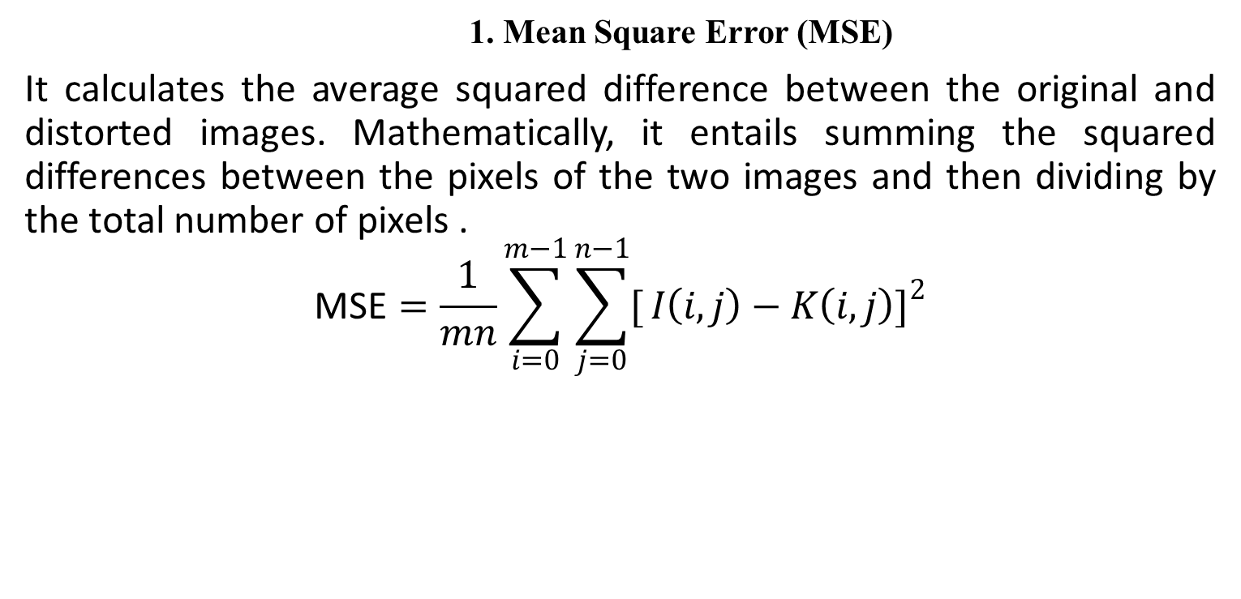
Performance / Evaluation Metrices
    1. Mean Square Error (MSE)
It calculates the average squared difference between the original and distorted images. Mathematically, it entails summing the squared differences between the pixels of the two images and then dividing by the total number of pixels .
$$\text{MSE}=\frac{1}{mn}\sum_{i=0}^{m−1}{\sum_{j=0}^{n−1}{[}}I\left(i,j\right)−K\left(i,j\right)]^{2}$$

Slide 20
2. Frechet Inception Distance (FID)
It assesses the similarity between generated images and real ones by scrutinizing their statistical characteristics.
𝐹𝐼𝐷 = ‖𝜇_{𝑟} − 𝜇_{𝑔}‖ + 𝑇𝑟 (∑_{𝑟} + ∑_{𝑔} − 2(∑_{𝑟}∑) 2)

Slide 21
Working Schedule

Slide 22
Expected Outcome
Whether the modification of DualGAN with the integration of labeled data as a warm start can led to performance improvements or not with comparison to DualGAN in image-to-image.
The final model is expected meet the stated objectives with measurable improvements, confirming the potential of labeled data to enhance the capabilities of generative adversarial networks

Slide 23
References
[1] Isola, P., Zhu, J.Y., Zhou, T., Alexei A. and Efros, A.A. (2017) Image-to-Image Translation with Conditional Adversarial Networks. 2017 IEEE Conference on Computer Vision and Pattern Recognition (CVPR), Honolulu, 21-26 July 2017, 5967-5976.
[2]Z. Yi, H. Zhang, P. Tan, and M. Gong, “DualGAN: Unsupervised Dual Learning for Image-to-Image Translation,” Proceedings of the IEEE International Conference on Computer Vision, Oct. 2017, doi: 10.1109/iccv.2017.310.
[3] A. Creswell, T. White, V. Dumoulin, K. Arulkumaran, B. Sengupta, and A. A. Bharath, “Generative Adversarial Networks: An Overview,” IEEE Signal Processing Magazine, vol. 35, no. 1, pp. 53–65, Jan. 2018, doi: 10.1109/msp.2017.2765202.
[4] P. Isola, J. Zhu, T. Zhou, and A. A. Efros, “Image-to-Image Translation with Conditional Adversarial Networks,” Proceedings of the IEEE Conference on Computer Vision and Pattern Recognition, Jul. 2017, doi: 10.1109/cvpr.2017.632.
[5]Y. Cao et al., “Recent advances of generative adversarial networks in computer vision,” IEEE Access, vol. 7, pp. 14985–15006, Jan. 2019, doi: 10.1109/access.2018.2886814.
[6] Yu, Y., Zhang, W. and Deng, Y., 2021. Frechet inception distance (fid) for evaluating gans. China University of Mining Technology Beijing Graduate School: Beijing, China. Vancouver.
[7] Liu, Shuangting, et al. "Pixel level data augmentation for semantic image segmentation using generative adversarial networks." ICASSP 2019-2019 IEEE International Conference on Acoustics, Speech and Signal Processing (ICASSP). IEEE, 2019.
[8] Pang, Yingxue, et al. "Image-to-Image Translation: Methods and Applications." arXiv preprint arXiv:2101.08629 (2021).
[9] Cao, Yang-Jie, et al. "Recent advances of generative adversarial networks in computer vision." IEEE Access 7 (2018): 14985-15006.
[10]A. Odena, “Semi-Supervised Learning with Generative Adversarial Networks,” arXiv (Cornell University), Jun. 2016, [Online].

Slide 24
Thank You

